Slide 1
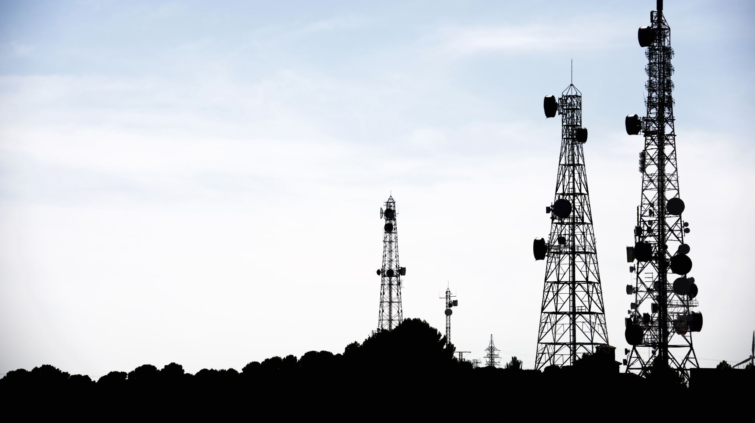
Telecom Customer Churn

Slide 2

Group Member Information
Mukul Rai 700748568
Shiva Godesala 700733582
Jaya Sai Charan Sammeta 700739775
Shruthi Vallap Reddy 700744517

Slide 3

Roles and Responsibilities
Mukul - ML techniques, Report
Shiva - PPT, Report
Jaya sai charan - Papers collection, Report
Shruthi - Exploratory Data Analysis, Report

Slide 4
Motivation
Customer churn can have a significant negative impact on telecom companies.
Acquiring new customers can be significantly more expensive than retaining existing ones.
Predicting customer churn allows telecom companies to proactively address customer concerns and improve the overall customer experience.
Today's highly competitive telecom industry, gaining a competitive edge is crucial.

Slide 5
Objective
Develop A churn prediction model
Obtain the relation between the customer’s characteristics and the churn
Provide the telecom companies an easy and effective way to predict customers who are going to churn
Gain competitive advantage
Increase customer retention

Slide 6
Related work
Presents a comprehensive review of various machine learning algorithms used for churn prediction in the telecom industry.
Random forests, gradient boosting, and deep learning for churn prediction in the telecom industry.
A comparative study of machine learning algorithms for predicting customer churn in the telecom industry.

Slide 7
Problem statement
Customer churn is a critical challenge faced by many businesses across various industries.
Losing customers can result in revenue loss, reduced market share, and increased costs to acquire new customers.
To proactively address this issue, businesses need to identify customers who are likely to churn and take appropriate actions to retain them.
Predictive model that can accurately forecast which customers are at risk of churning.

Slide 8
Proposed Solution
High-level implementation outline for telecom churn prediction using logistic regression, support vector machine (SVM), adaptive boosting (ADA), XGBoost, and random forest algorithms.
Logistic regression is a binary classification technique that is commonly used for churn prediction.
Using ADA in telecom churn prediction can provide telecom companies with a powerful tool to accurately identify customers at risk of churning and take appropriate actions to retain them.

Slide 9
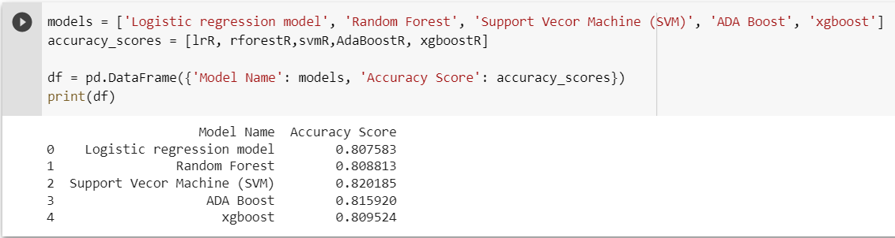
Results
Fig 01: Comparison of model accuracy

Slide 10
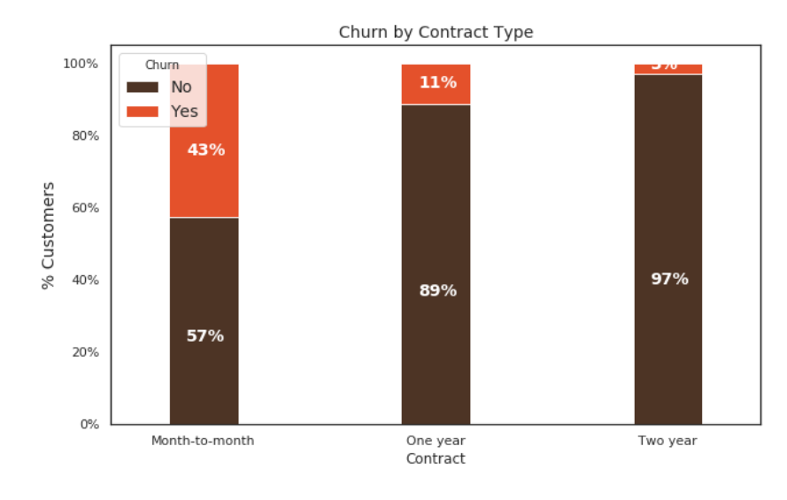
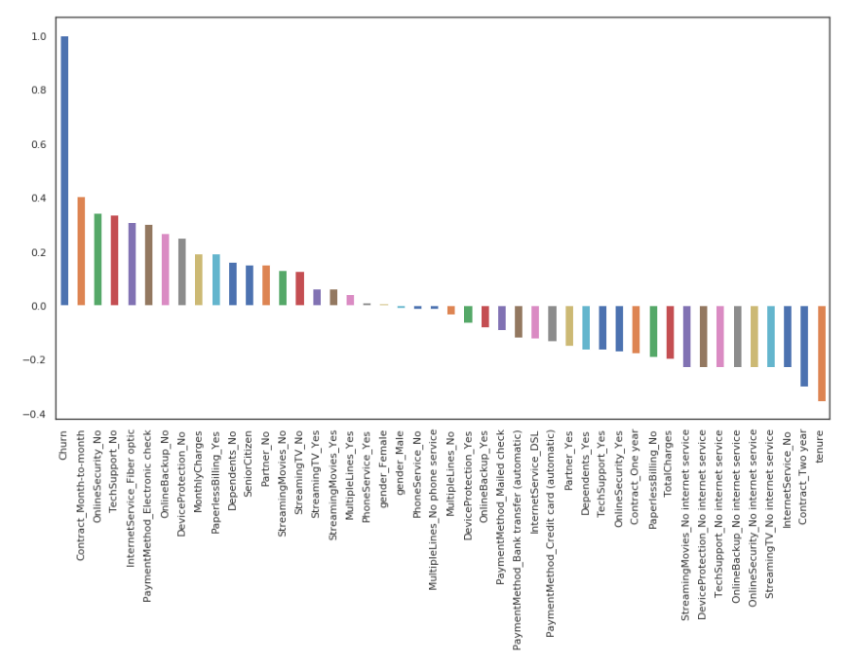
Fig 2 Churn with other varaibles
Fig 1 Churn by contract type

Slide 11
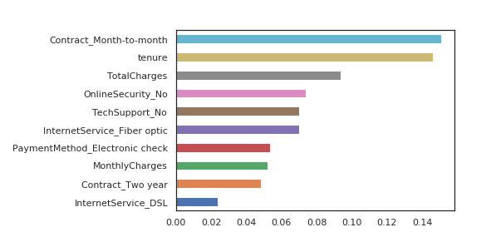
Fig 4: Features Importance graph

Slide 12
References
[1] Wei, L., & Zheng, H. (2017). Predicting customer churn in the telecommunications industry using machine learning algorithms. International Journal of Computer Science and Telecommunications, 8(5), 145-150.. 2018 9th
[2] Gunes, E., & Buyukyilmaz, Y. (2019). Predicting customer churn in the telecom industry using machine learning algorithms. 2019 27th Signal Processing and Communications Applications Conference (SIU), 1-4.
[3] Abualigah, L. M., Gupta, P., & Al-Mallah, M. H. (2019). Predicting customer churn in the telecom industry using machine learning algorithms. PLoS One, 14(8), e0221470.
[4] Bhattacharya, A., & Saini, S. (2018). Customer churn prediction in telecom using machine learning algorithms. 2018 9th International Conference on Computing, Communication and Networking Technologies (ICCCNT), 1-6. International Conference on Computing, Communication and Networking Technologies (ICCCNT), 1-6.

